Slide 1


Bangladesh Army University of Engineering & Technology (BAUET)
Qadirabad, Natore-6431
Department of Computer Science and Engineering
Course Code: CSE-4000
Course Title: Thesis/Project
Presentation on: Real Time Vehicle Detection Using Deep Neural Network
Submitted By:
Name: Mohammad Nurullah
ID:20104041
Name: Md. Shahriar Pervez Efti
ID:20104049
Name: MD Mijanur Rahman
ID:19204046
Batch: 11th
Session:2020-2021
Supervised By:
Aroni Saha Prapty
Lecturer,
Department of CSE, BAUET

Slide 2

Table of Content
Introduction
Literature Review
Motivation
Objectives
Dataset
Methodology
Result Analysis
Future Work
Conclusion
Reference

Slide 3
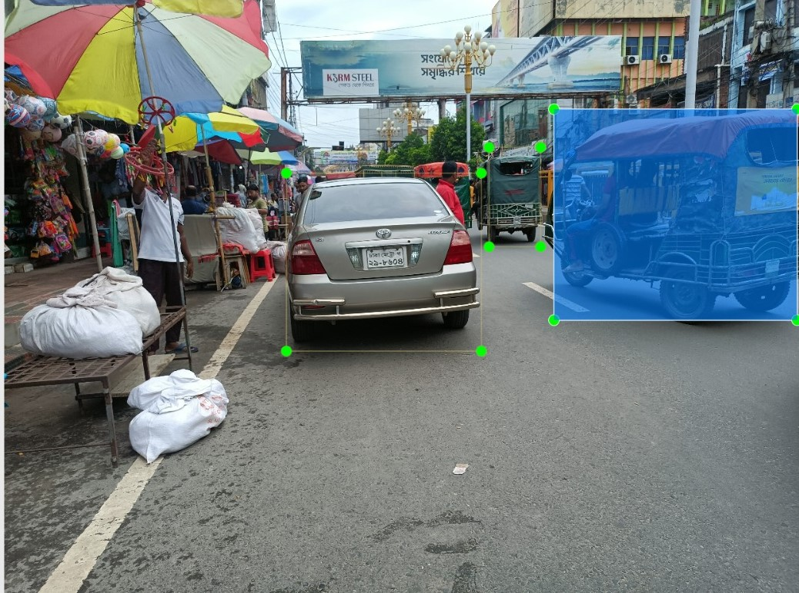
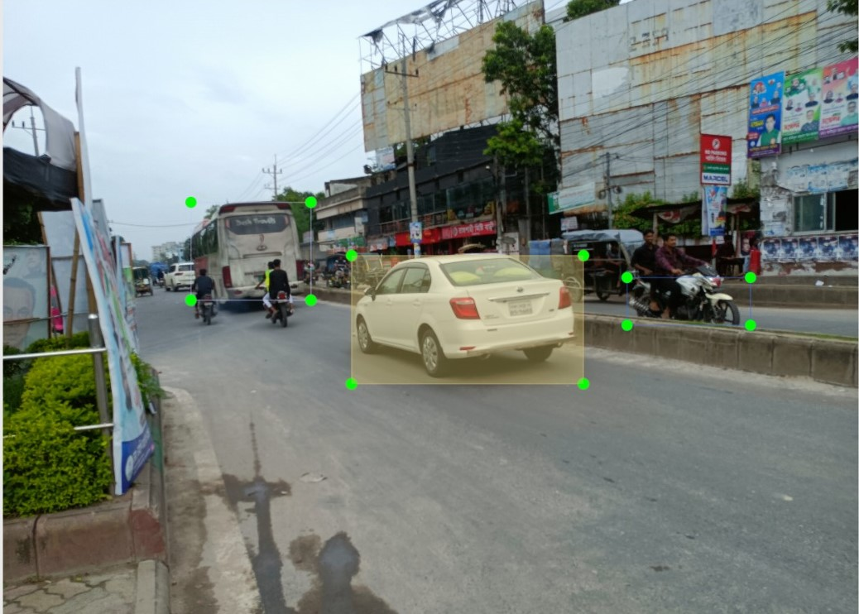
Introduction
Vehicle recognition is essential for developing an Intelligent Transport System (ITS). It includes the task of:
Detection
Classification
Localization
Figure-01: Recognition of Vehicle

Slide 4
Literature Review
25 Papers
Evolution Techniques
Practical Applications

Slide 5
Literature Review (contd.)
Serial Number | Topic Name | Number of Dataset | Algorithm | Accuracy
1 | Real-Time Yolo Based Vehicle Detection. | 56987 images | Inception-ResNet | 72.92%
2 | VAID: An Aerial Image Dataset for Vehicle Detection and Classification. | 959 images | VGGNet | 71.17%
3 | Vehicle Detection Using Deep Learning Technique inTunnel Road Environments. | 7083 images | RetinaNet | 72%
4 | Vehicle Detection in High ResolutionSatellite Remote Sensing ImagesBased on Deep Learning. | 2000 images | Region-based CNN (R-CNN) | 78.00%
5 | Vehicle Detection from Aerial Images Using Deep Learning:A Comparative Study. | 84000 images | ResNet | 79.45%
Table 1: Some Paper Review

Slide 6
Motivation
Technological Significance
Research Gap and Contribution
Demand for Efficiency

Slide 7
Objectives
Create a new dataset of Bangladeshi local vehicles.
Augment images to increase dataset size.
Train and Test on several pre-trained models.
Analyze the outcome .

Slide 8
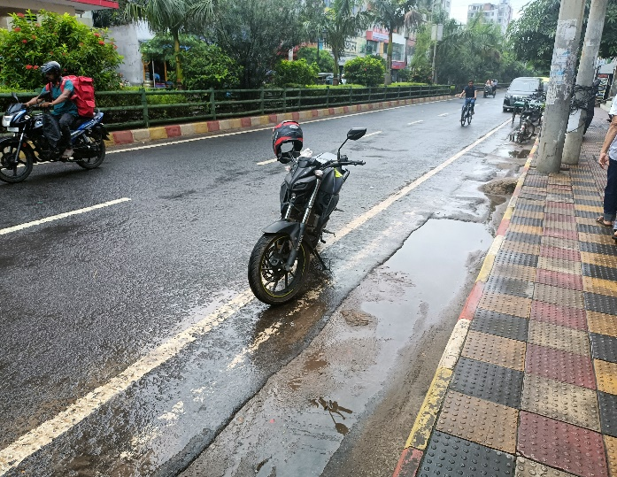
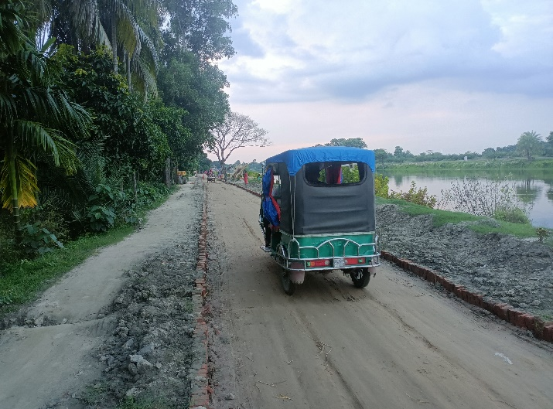
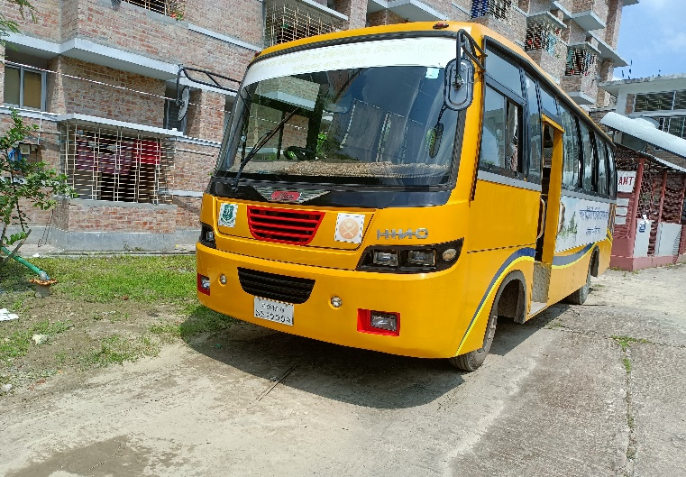
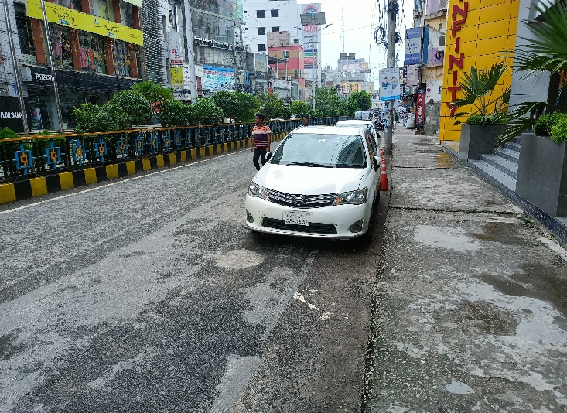
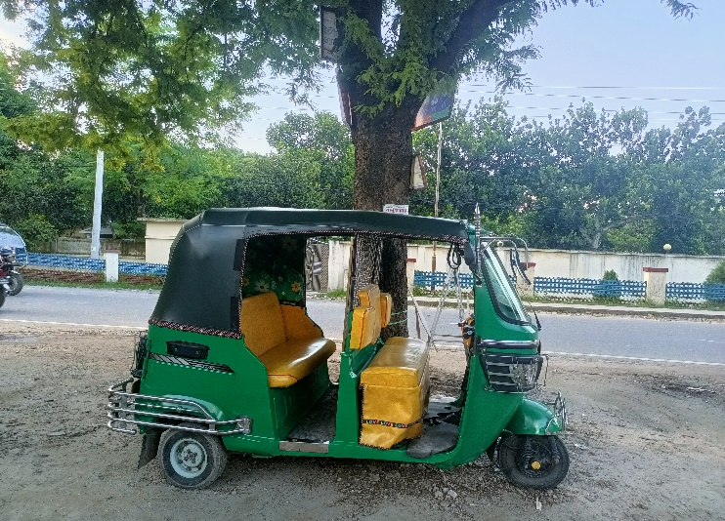
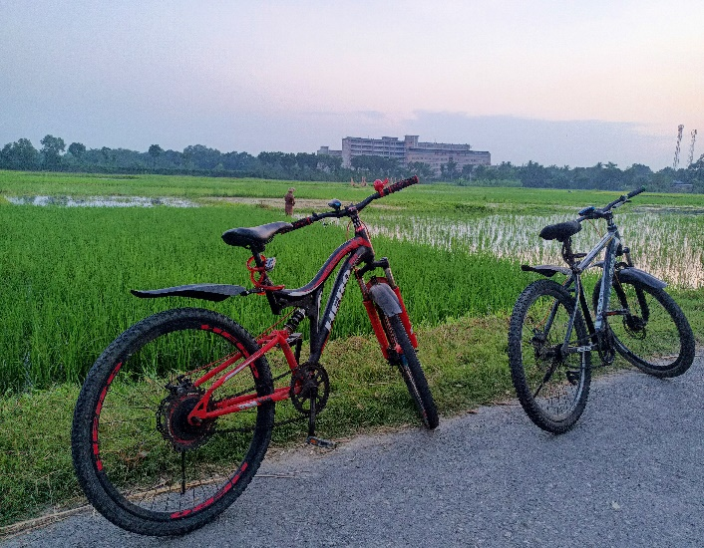
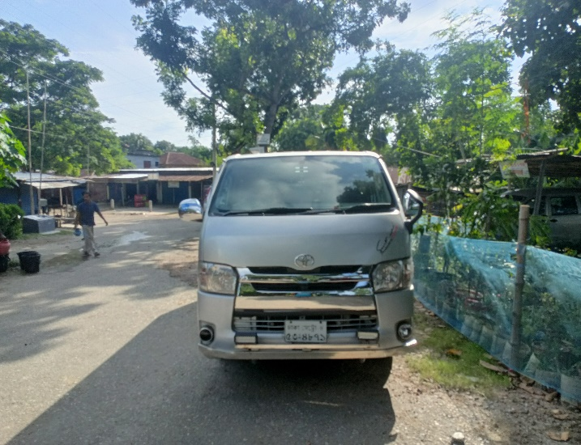
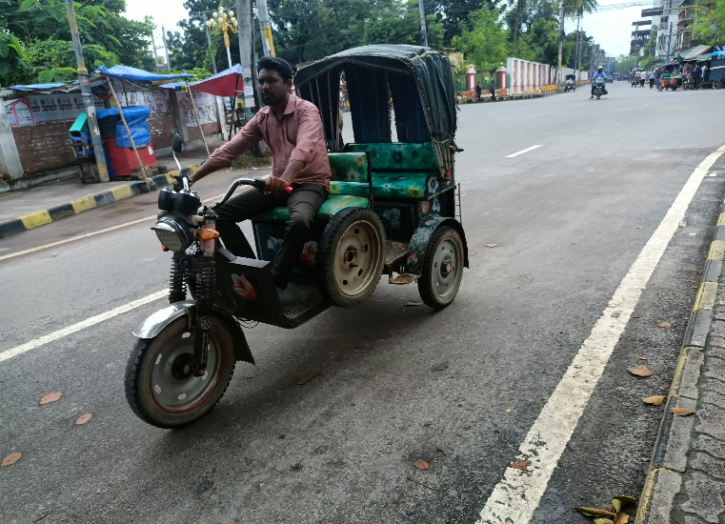
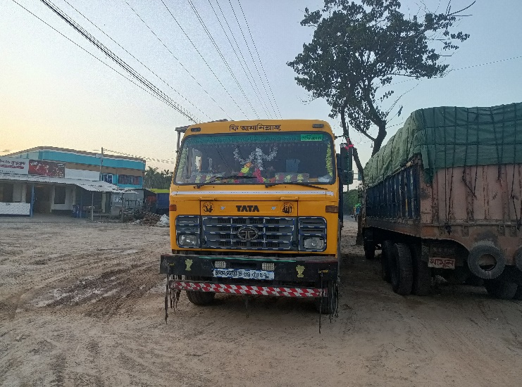
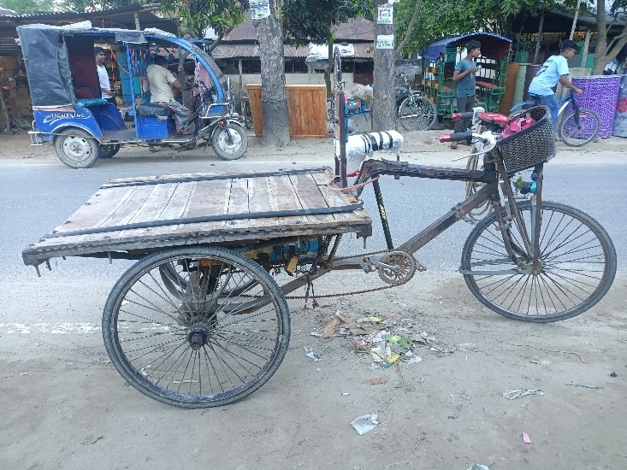
Dataset
The chosen Vehicle from Bangladesh road.
Includes:
10 types of most common local vehicle.
Approximately 7,000 images initially.
After Augmentation 19,994 images.
Figure-02: Examples of Dataset

Slide 9
Dataset
Collected vehicle images from Dayarampur, Bonpara ,Dhaka, and Rajshahi cities.
Classes are: Auto, Bike,Bus,CNG,Car, Cycle Microbus,Rickshaw,Truck,Van
Performed augmentation on images.
Name | Description
Resize | For ease of use all images are resized to 256x256px size while preserving the aspect ratio.
Rotation | Images are randomly selected and randomly rotated in between -10 to +10 degrees to generate double images.
Blur | Randomly selected images are blurred
Noise | Noise are added to randomly selected images to increase the image number by thrice.
Table 2: Augmentation details

Slide 10
Dataset
Dataset is divided into train, validation and test set
Vehicle Type | Train Set | Validation Set | Test Set | Total
Auto | 1855 | 146 | 52 | 2053
Bike | 2105 | 198 | 53 | 2356
Bus | 2308 | 259 | 60 | 2627
CNG | 1515 | 110 | 45 | 1670
Car | 2005 | 170 | 56 | 2231
Cycle | 2011 | 121 | 52 | 2184
Microbus | 1465 | 106 | 45 | 1616
Rickshaw | 1626 | 119 | 45 | 1790
Truck | 1503 | 104 | 42 | 1649
Van | 1670 | 108 | 40 | 1818
Grand Total |  |  |  | 19994
Table 3: Class wise image distribution in Vehicle-BD dataset

Slide 11
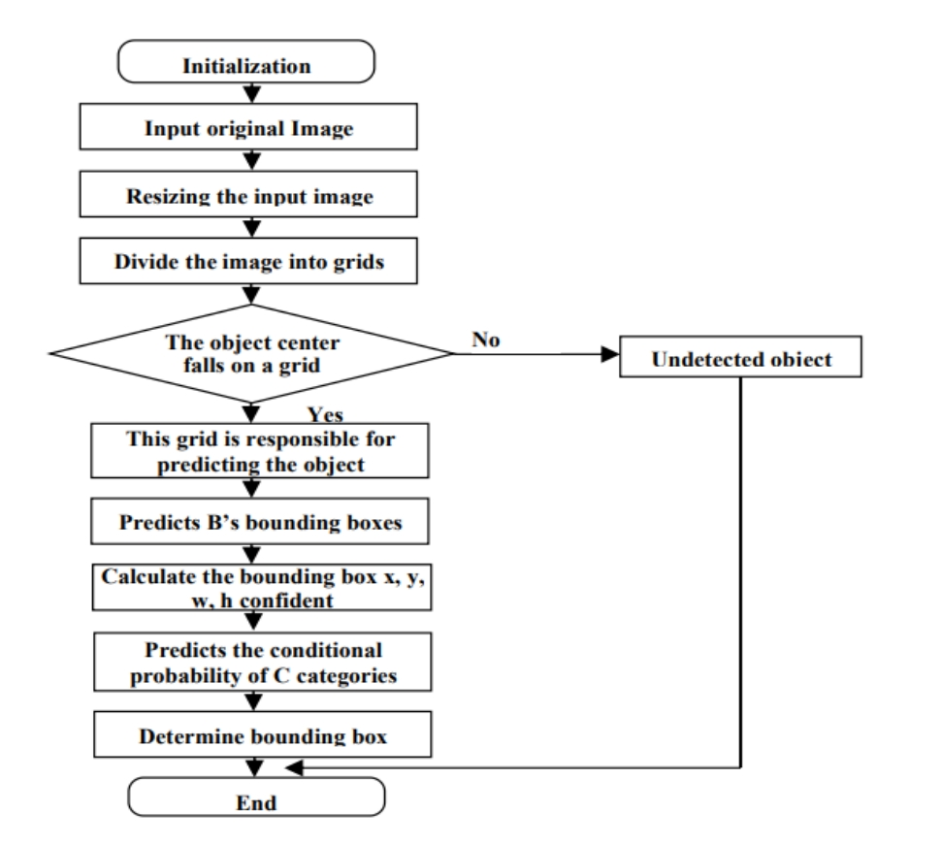
Methodology
YOLOv8 (You Only Look Once v8)
Directly Predict Bounding Box
Grid Wise Detection
Open Source Implementation
Figure-03: YOLO Detection Flowchart

Slide 12
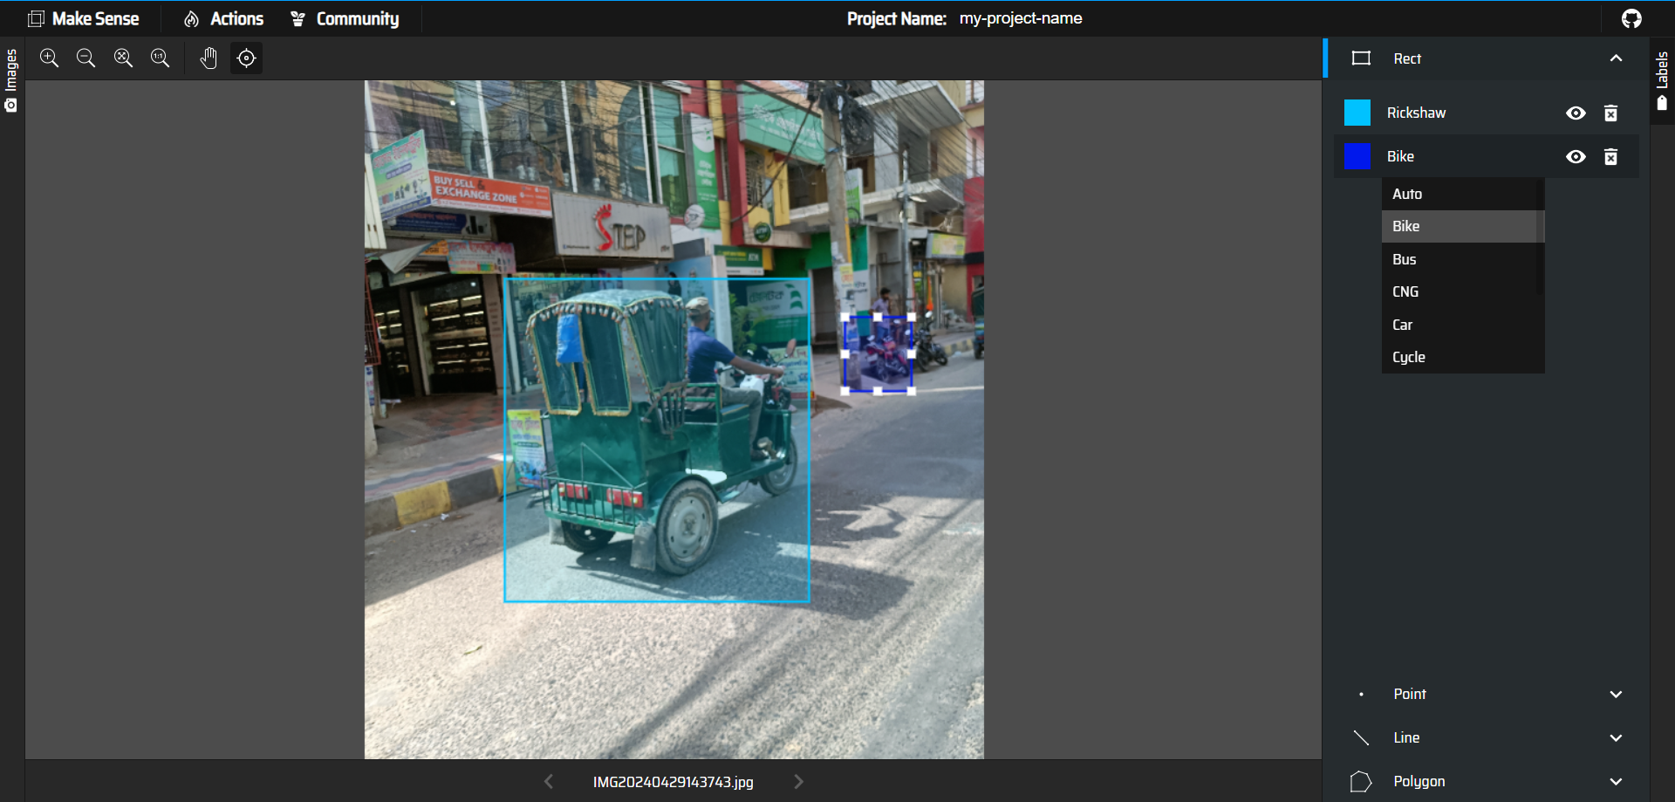
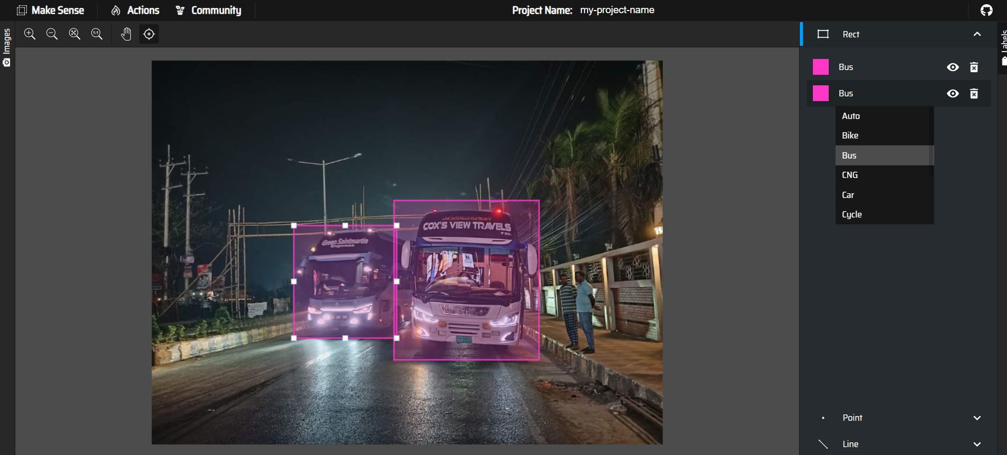
Methodology(contd.)
Figure-04: Annotation of Dataset by Class

Slide 13
Methodology(contd.)
Methodology includes:
Pre-defined model selection
Training and testing pre-trained models with collected dataset.
Pre-trained Model Selection
Pre-trained Model
Fine-tuning Model
Output
Test Set
Train and Validation Dataset
Figure-05: Proposed Methodology Block Diagram

Slide 14
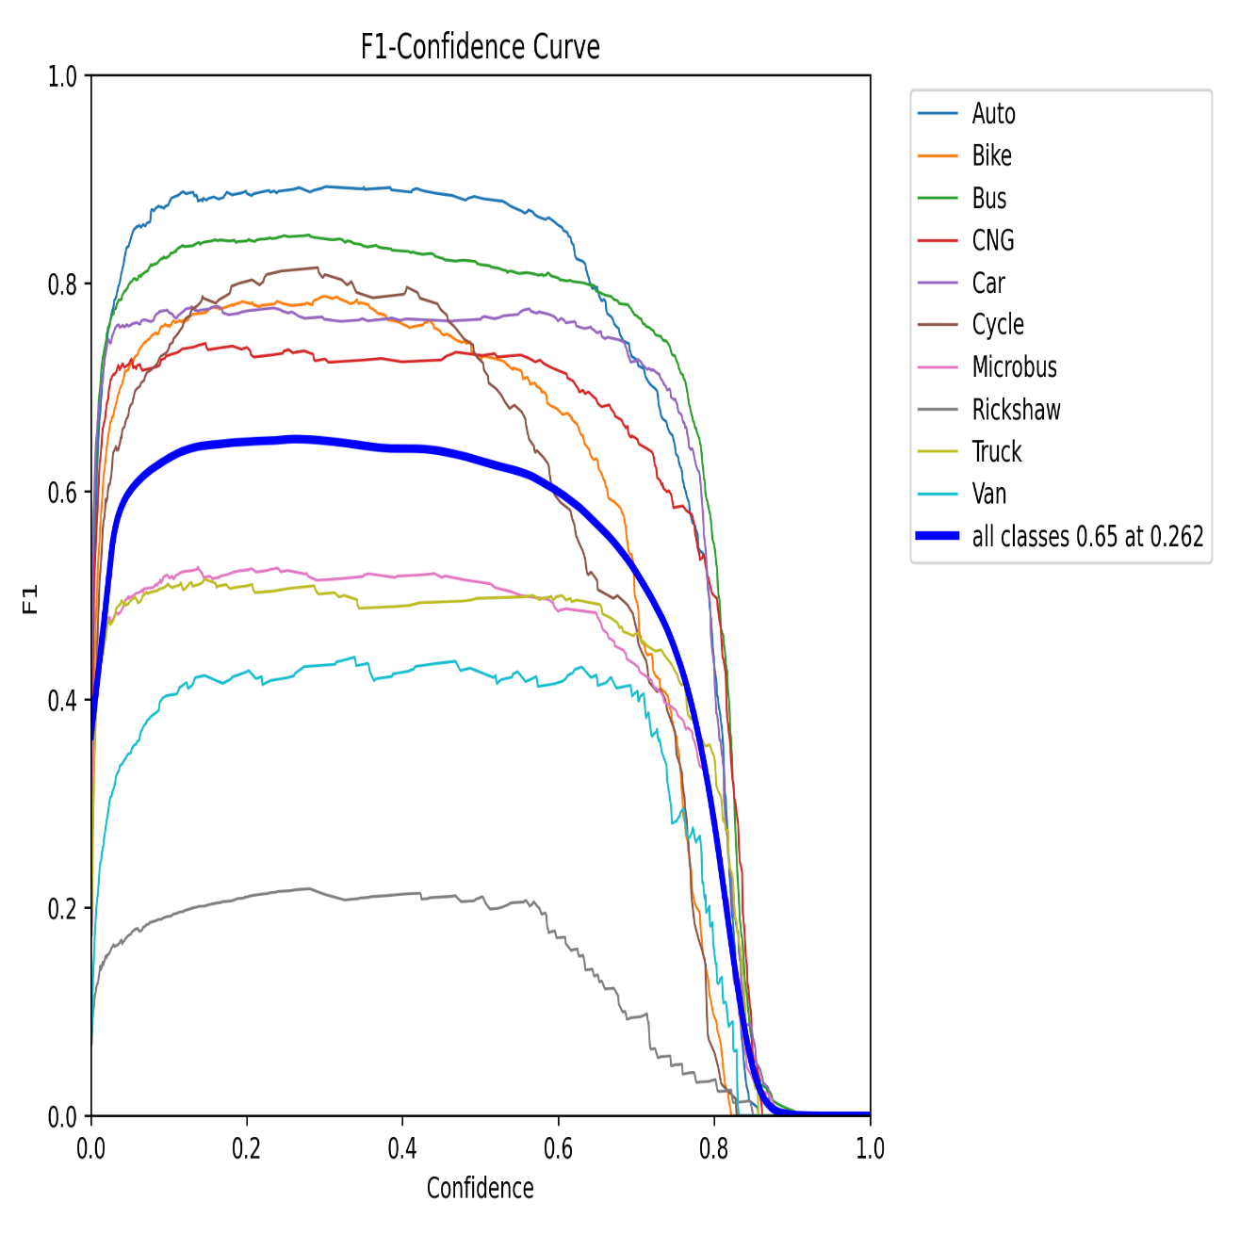
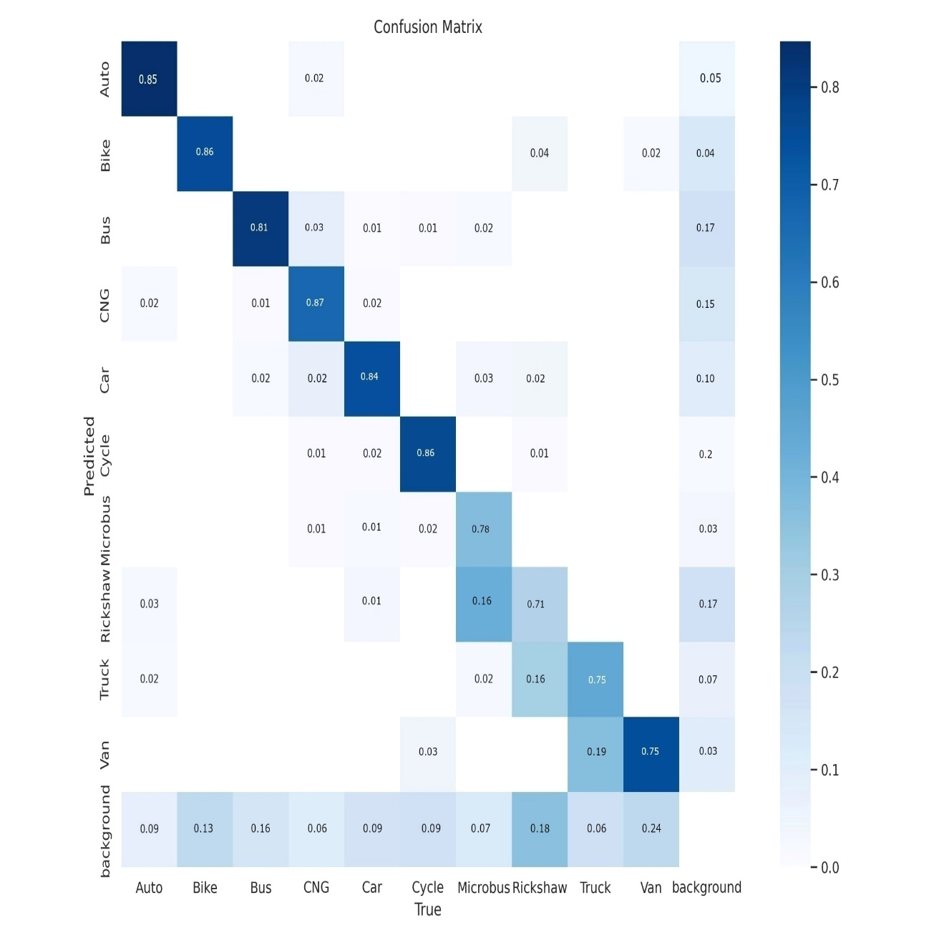
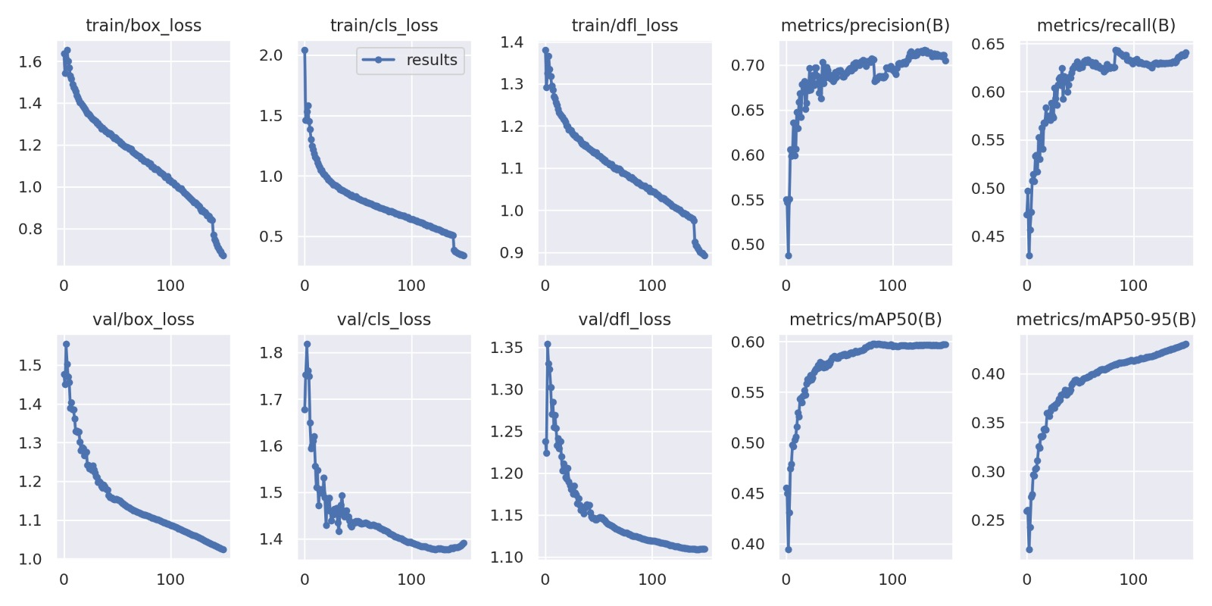
Result Analysis
Figure-06: F1 score ,Confusion Matrix and Validation Score

Slide 15
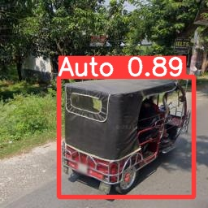
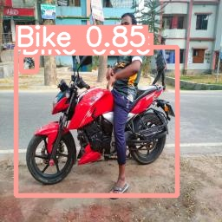
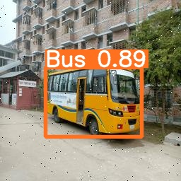
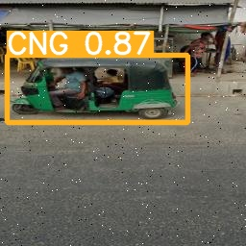
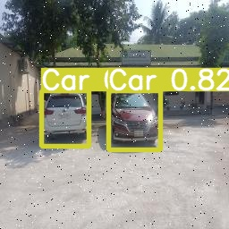
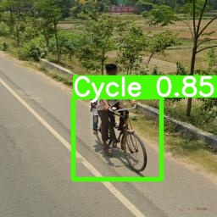
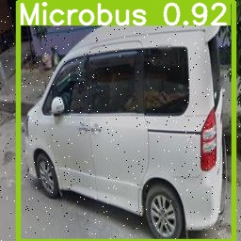
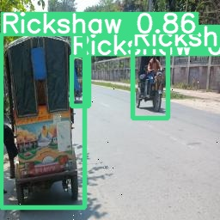
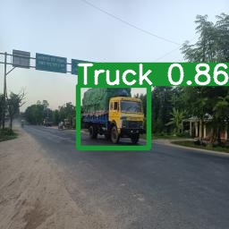
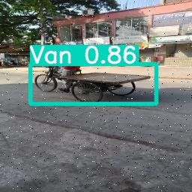
Result Analysis
Figure-07: Confidence Value of Vehicle Class

Slide 16
Future Work
Processing Optimization
Multi-Object Detection and Tracking
Continual Learning and Adaptation
Ethical Considerations
Privacy-Preserving
Explainable AI

Slide 17
Conclusion
Real-time vehicle detection
Deep Neural Network enables swift identification
Use Smart Phone
Supports applications like traffic management and autonomous driving
Efficient neural networks process information in milliseconds
Ensures timely and accurate vehicle detection in dynamic environments

Slide 18
Reference
[1] | Ammar, A., Koubaa, A., Ahmed, M., Saad, A., & Benjdira, B. (2021Real-Time Yolo Based Vehicle Detection. A comparative study. Electronics (Switzerland), 10(7). https://doi.org/10.3390/electronics1007082020
[2] | Mahto, P., Garg, P., Seth, P., & Panda, J. (2020). VAID: An Aerial Image Dataset for Vehicle Detection and Classification. 11(5), 409–419. https://doi.org/10.34218/IJARET.11.5.2020.043
[3] [4] [5] | Lin, H. Y., Tu, K. C., & Li, C. Y. (2020). Vehicle Detection Using Deep Learning Technique inTunnel Road Environments. IEEE Access, 8, 212209–212219. https://doi.org/10.1109/ACCESS.2020.3040290 Tan, Q., Ling, J., Hu, J., Qin, X., & Hu, J. (2020). Vehicle Detection in High ResolutionSatellite Remote Sensing ImagesBased on Deep Learning. IEEE Access, 8, 153394–153402. https://doi.org/10.1109/ACCESS.2020.3017894 Guan, L., Chen, Y., Wang, G., & Lei, X. (2020). Vehicle Detection from Aerial Images Using Deep Learning:A Comparative Study. (Switzerland), 9(3). https://doi.org/10.3390/electronics9030451

Slide 19



Any
Question?

Slide 20



THANK
YOU

